Slide 1

Metabolism
Lesson 3.1: Learning About Energy Release in the Body

Slide 2
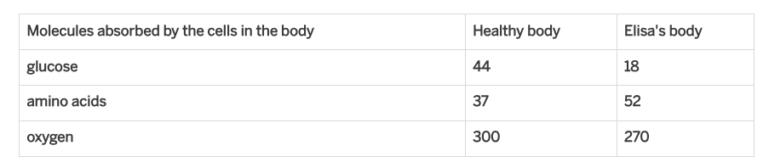
Warmup Page 60
The data table below shows Elisa’s test results and test results from a healthy body. Use the data to answer the questions below the table.
Compared to the cells in a healthy body, Elisa’s cells are getting far fewer _________ molecules.
How do you think getting fewer of these molecules to her cells contributed to Elisa’s tiredness? Explain your ideas.

Slide 3

Considering Claims About Energy Release
Elisa was feeling extremely tired. Based on the analysis you did, we now know that she has diabetes, a condition that prevents glucose from entering the cells in her body.

Slide 4
Chapter 3 Question:
How do molecules in the cells of the body release energy?

Slide 5
Considering Claims About Energy Release
Choose the claim you think is most accurate:
Claim 1: Cells need glucose to release energy.
Claim 2: Cells need amino acids to release energy.
Claim 3: Cells need oxygen to release energy.
Claim 4: Cells need glucose AND amino acids to release energy.
Claim 5: Cells need glucose AND oxygen to release energy.
Claim 6: Cells need ALL THREE types of molecules to release energy..

Slide 6
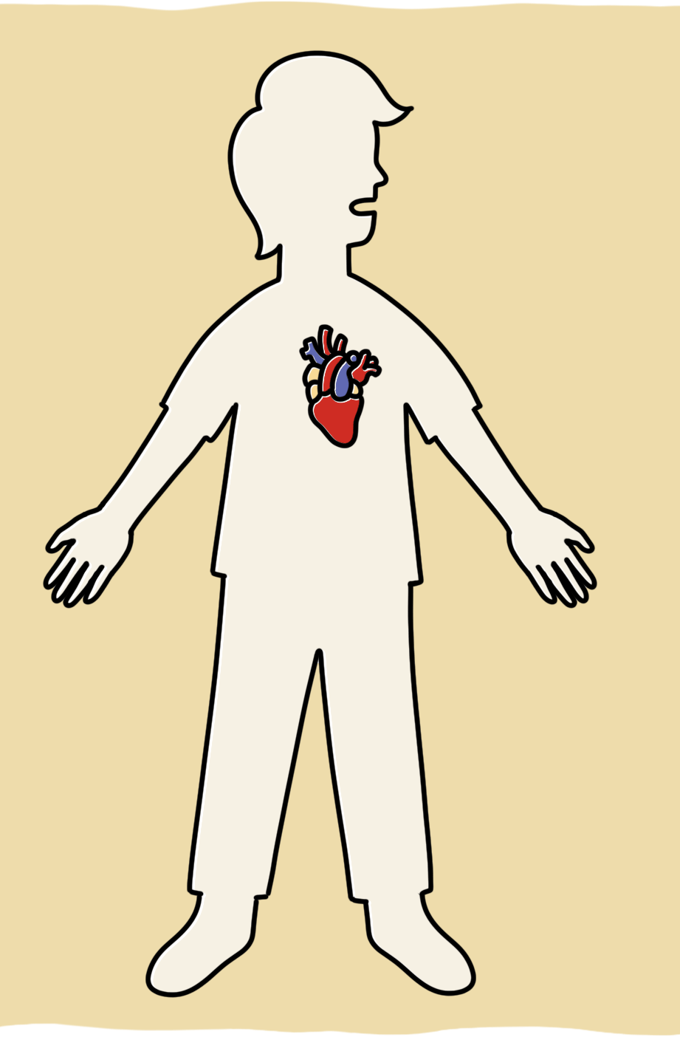
Gathering Evidence from Heart and Breath Rates
We’ll be gathering evidence today to help figure out which claim is best supported.
We’ll start by observing what happens in our bodies when we increase our activity level by running in place. Since movement requires energy, we can see what happens to the body when it uses more energy.
You will observe your heart rate and breath rate before and after you run in place.
What could changes to your heart rate and breath rate tell you about what is going on inside your body?

Slide 7
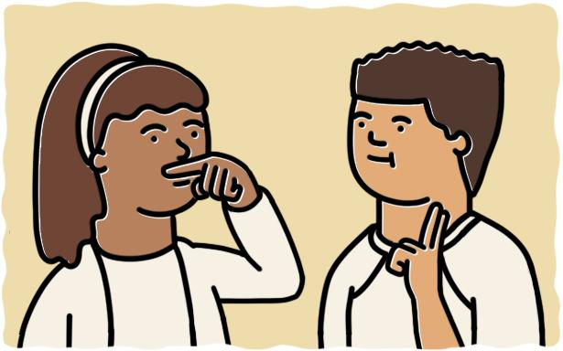
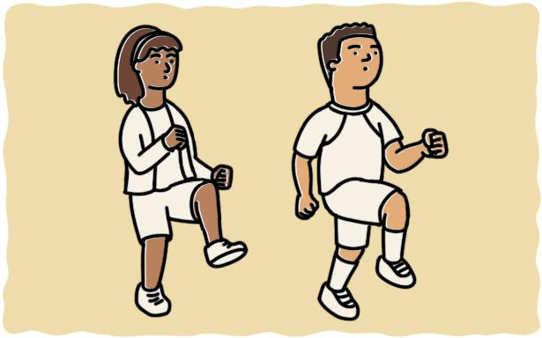

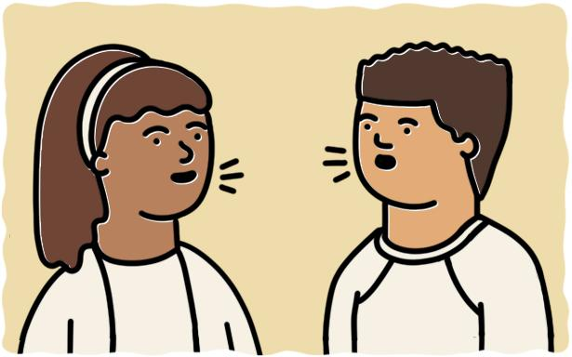
Heart and Breath Rate Activity
Observe
Exercise
Observe again
Discuss
Observe breath rate by putting a finger under your nose.
Observe heart rate by finding your pulse.
At my signal, run in place for one minute. Lift your knees as high as you can and as fast as you can. Listen for the signal to stop.
As soon as you stop exercising, observe your breath and heart rate as you did before.
How did your breath rate change after exercise?
How did your heart rate change after exercise?
Investigation Notebook pg 62

Slide 8

Observing Heart Rate
—--------
Step 1
Place two fingers gently on your neck, just under your jaw (or on your wrist).
Step 2
Move your fingers around until you can feel a steady beat.
Step 3
Each beat you feel is a pulse of blood from one pump of the heart.

Slide 9
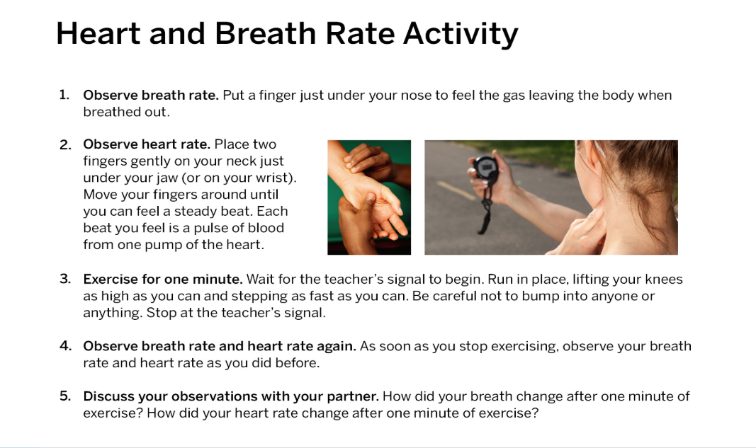

Slide 10
Observing Heart Rate
What happened to your breath rate?
Which molecule is taken into the body from the air with each breath?
Why do you think the respiratory system took in more of this molecule when you were running?
What happened to your heart rate?
What does the increased heart rate tell us about the circulatory system?
Why do you think the circulatory system was pumping blood faster when you were running?

Slide 11
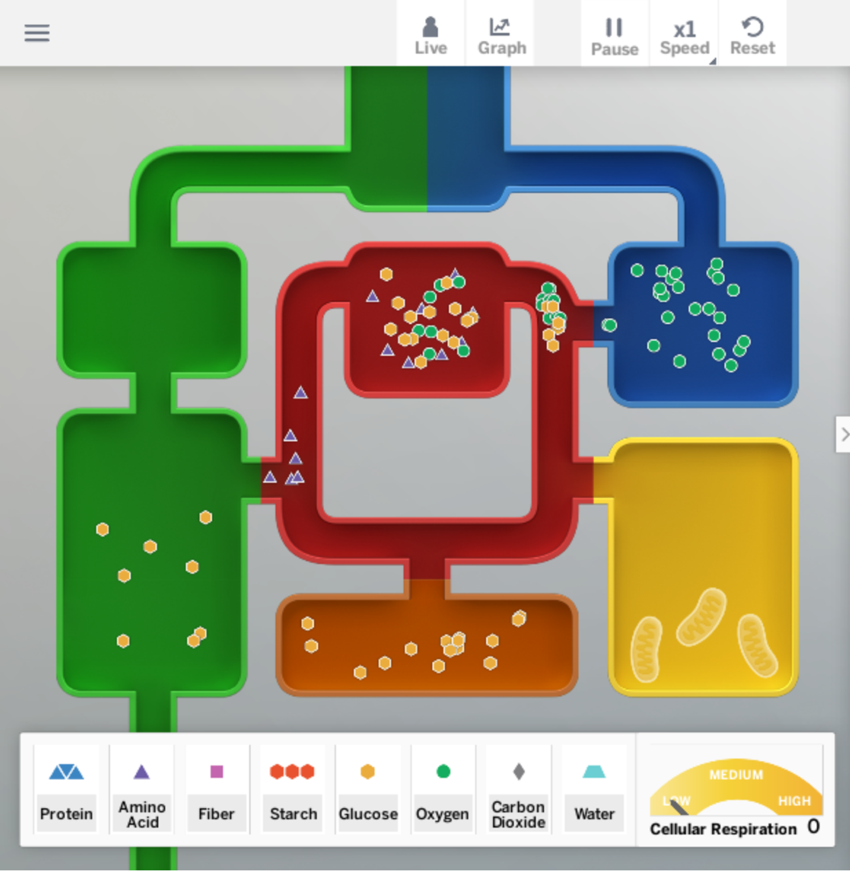
Gathering Evidence from the Sim
We will use the Metabolism Simulation to get more evidence about the relationship between energy and the molecules that are getting to the cells.
You will conduct three tests in the Sim to determine which molecules are needed in the cells for energy release.
In each test, you will eliminate one molecule—either glucose, oxygen, or amino acid molecules—and then see how that affects the body’s ability to release energy.

Slide 12
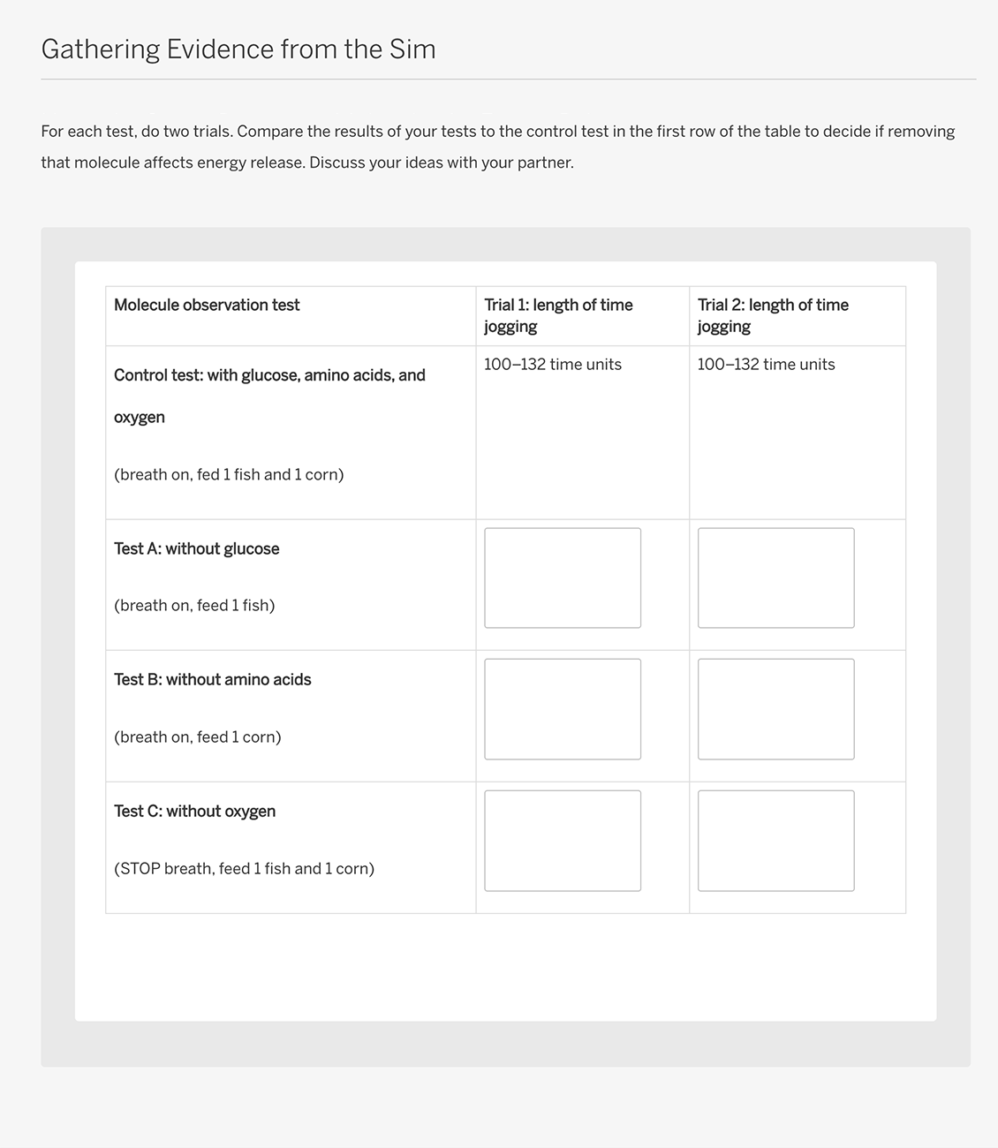

Gathering Evidence from the Sim
Notice that the first row of the data table is already completed with a control test. You will compare your tests to the control test to see if there was a change.
The Sim is designed so when there is not enough energy being released in the cells, the activity level drops.
By measuring how long the body can keep jogging, we are indirectly measuring how much energy is being released in the cells.
Investigation Notebook pg 63

Slide 13
Revising Claims
Claim 1: Cells need glucose to release energy.
Claim 2: Cells need amino acids to release energy.
Claim 3: Cells need oxygen to release energy.
Claim 4: Cells need glucose AND amino acids to release energy.
Claim 5: Cells need glucose AND oxygen to release energy.
Claim 6: Cells need ALL THREE types of molecules to release energy..
You collected evidence from two sources: your own body and the Sim.
Now, you’ll return to the claims and discuss which claim you think our new evidence best supports. It’s okay if you have changed your mind; scientists regularly revise their claims when they get new evidence.
Which molecules do cells need to release energy? Explain how the evidence supports this claim.

Slide 14
Key Concept #8:
In order to release energy, cells need both glucose and oxygen molecules.

Slide 15
Elisa had low levels of glucose molecules in her cells due to the condition diabetes.
The evidence you gathered reveals why Elisa’s low glucose levels contributed to her extreme tiredness. We will continue to learn more about how energy is released in the cells in the next lesson.

Slide 16
Homework: pg 65-66
For this activity, you will run additional Sim tests to compare two different activity levels in the Healthy Body. Then, you’ll record your results in a data table.
Run tests to compare two different activity levels in the Healthy Body of the Metabolism Simulation.
Select HEALTHY BODY and select TEST.
Food Queue: 6 corn.
Do two trials for each activity level (Rest and Jog).
Record your results in the data table, and then answer the questions below the data table.

